Slide 1
Problem Definition
A leading Middle Eastern bank seeks to analyze its customer base and marketing campaigns to identify customers most likely to take a term deposit.
45211 Data sample
20 Features
Objective is to predict whether the client will subscribe to a Term Deposit or not

Slide 2
Methodology
TOOLS USED
SNO | TOOL | Description
1 | Programming Language | Python
2 | Distribution Platform | Anaconda
3 | Environment | Jupyter Notebook

Slide 3
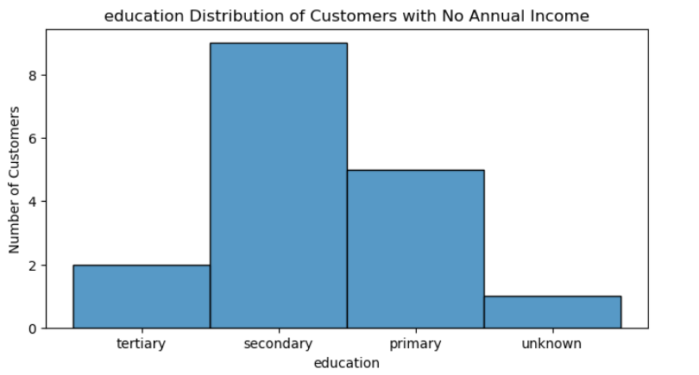
NO ANNUAL INCOME DISTRIBUTION Based on Education
Number of Customers with no Annual income: 17
The chart shows that out of 17 customers with no annual income:
The majority (9 customers) have a secondary education.
5 customers have a primary education.
2 customers have a tertiary education.
Only 1 customer has an unknown education level.

Slide 4
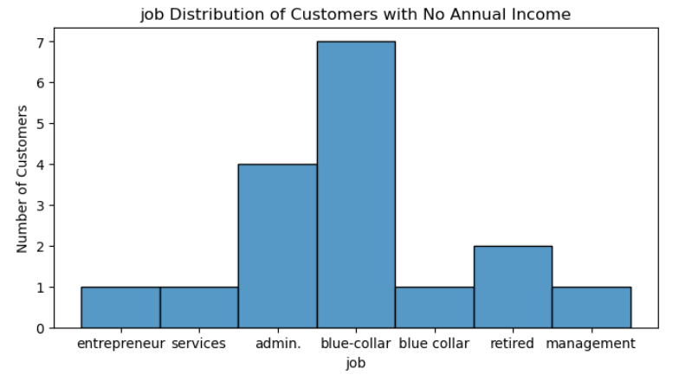
NO ANNUAL INCOME DISTRIBUTION Based on JOB
The largest group of customers with no annual income works in the blue-collar job category, with 7 individuals.
The admin job category has 4 customers without an annual income.
Retired individuals and those in the management sector each have 2 customers with no annual income.
Entrepreneur, services, and blue-collar jobs each have 1 customer without an annual income.

Slide 5
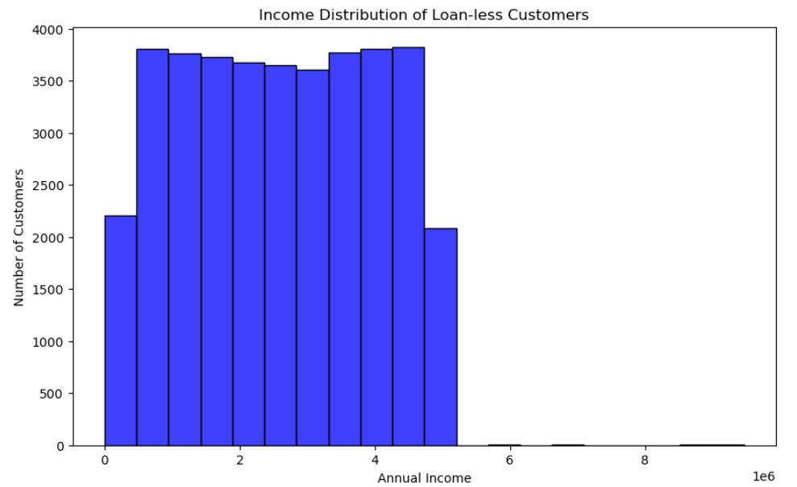
Analyze customers without any loans
Income Distribution Of Loan-less Customers

Slide 6
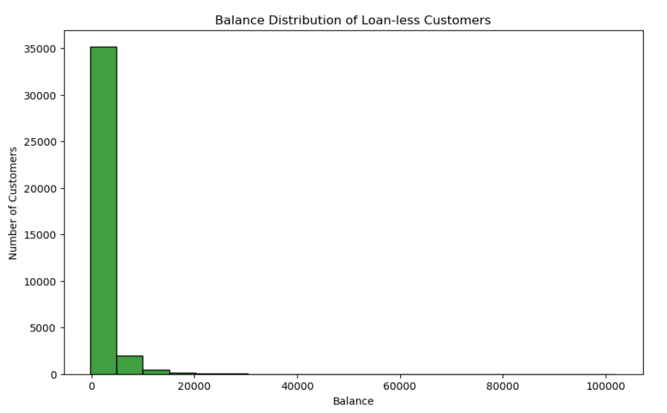
Balance Distribution of Loan-less Customers

Slide 7
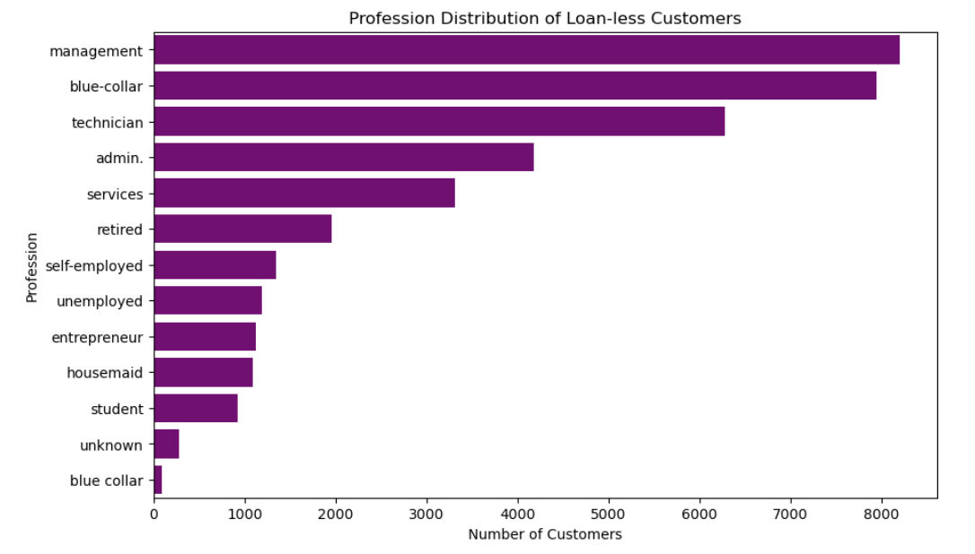
Profession Distribution of Loan-less Customers

Slide 8
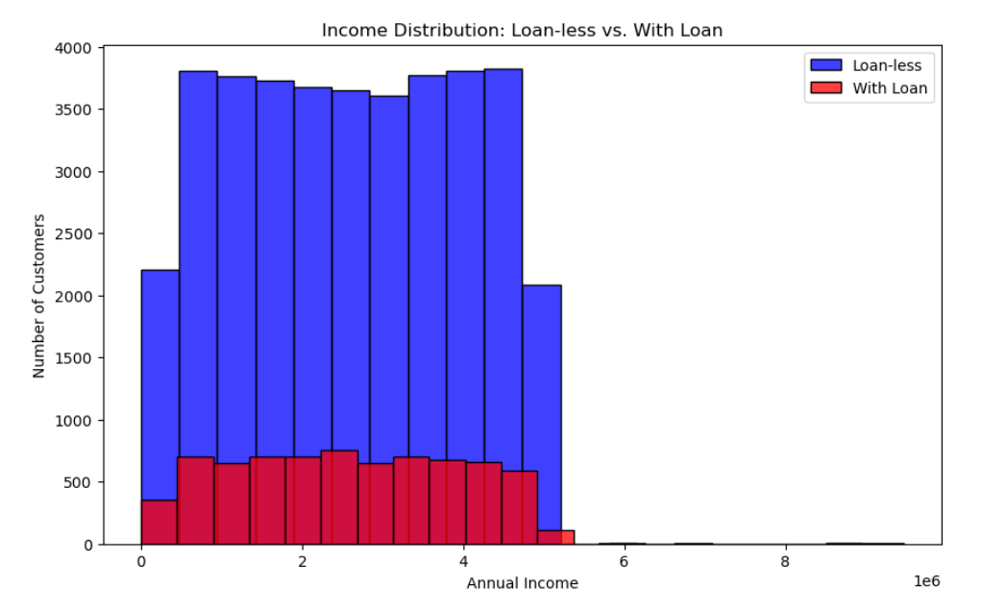
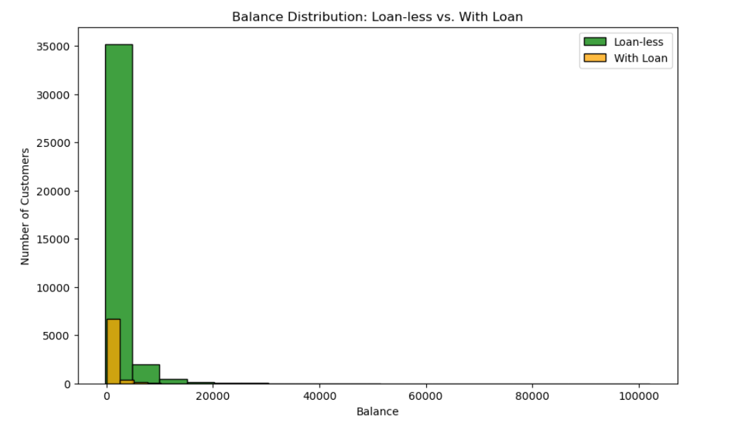
Income Distribution: Loan-less vs. With Loan
Balance Distribution: Loan-less vs. With Loan

Slide 9
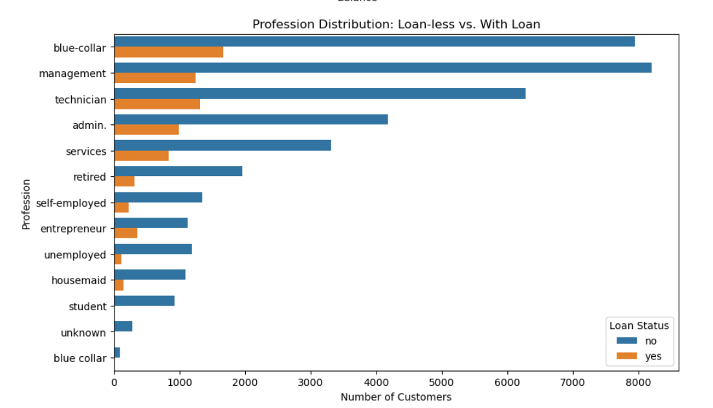
Profession Distribution: Loan-less vs. With Loan

Slide 10
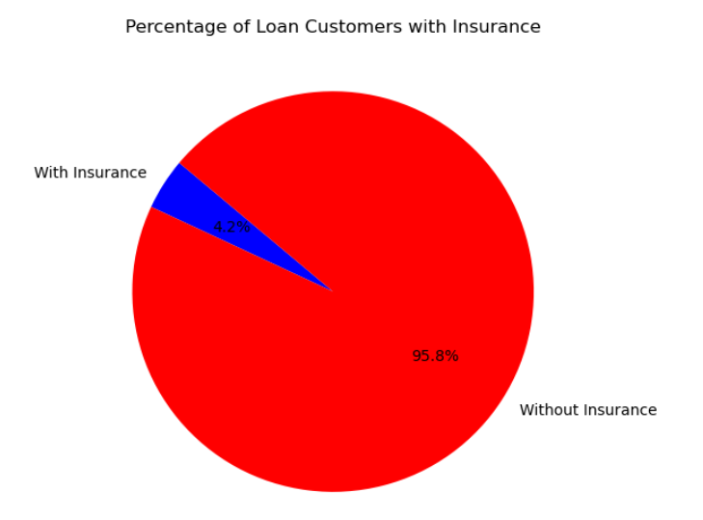
Loan and Insurance Analysis
Percentage of customers with a loan who have taken out insurance: 4.16%
Discussion of Potential Implications:
If many customers with loans also have insurance, it could mean they’re more aware of managing financial risks because they have extra liabilities. On the other hand, if few loan customers have insurance, the bank might see this as a chance to better promote insurance to them, as they might not be fully covered. Understanding this link helps the bank profile customers better and predict which groups might be more likely to buy insurance, allowing for more targeted marketing efforts.

Slide 11
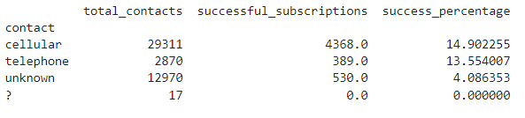
Communication Strategy Insights
Cellular: The most effective contact method, with 29,311 contacts leading to 4,368 successful subscriptions (14.9% success rate).
Telephone: Moderate effectiveness, with 2,870 contacts resulting in 389 successful subscriptions (13.6% success rate).

Slide 12
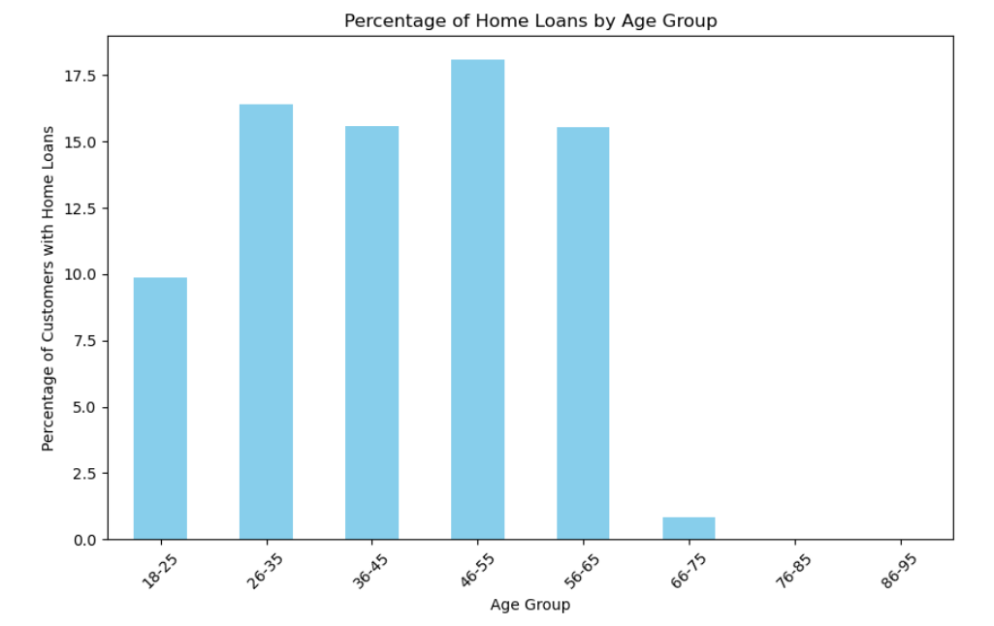
Age and Home Loans

Slide 13
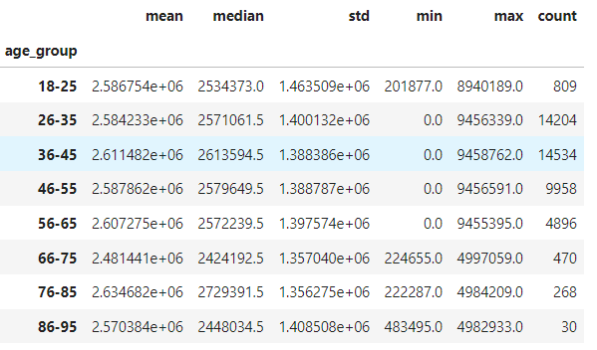
Income and Age Relationship

Slide 14
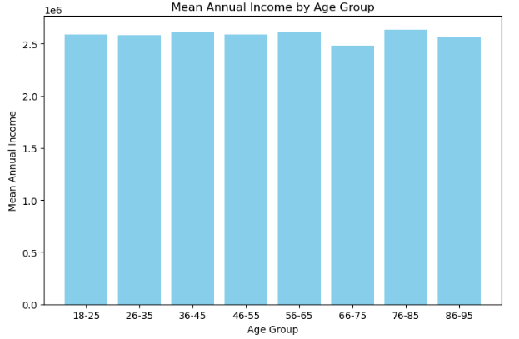
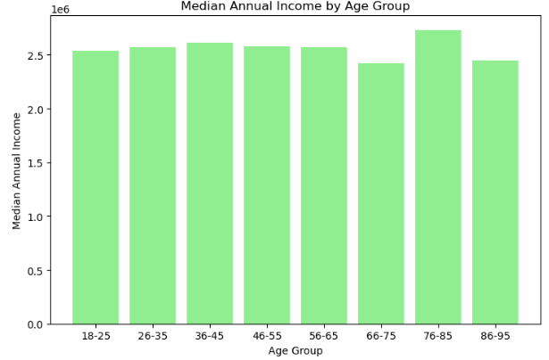
Mean Annual Income by Age Group
Median Annual Income by Age Group

Slide 15
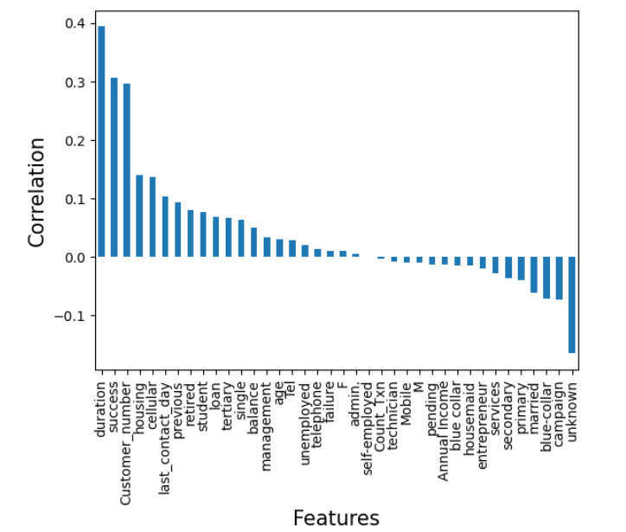
Modelling
Term Deposit and Related Variables
Positive Correlations:
Duration has the highest positive correlation, indicating a strong relationship with the target variable.
Other positively correlated features include success, housing, and cellular.
Weak Correlations:
Several features show weak or negligible correlation, such as Annual Income, pending, Mobile, and technician.
Negative Correlations:
unknown has the strongest negative correlation.
Other features with negative correlations include campaign, married, and blue-collar.

Slide 16
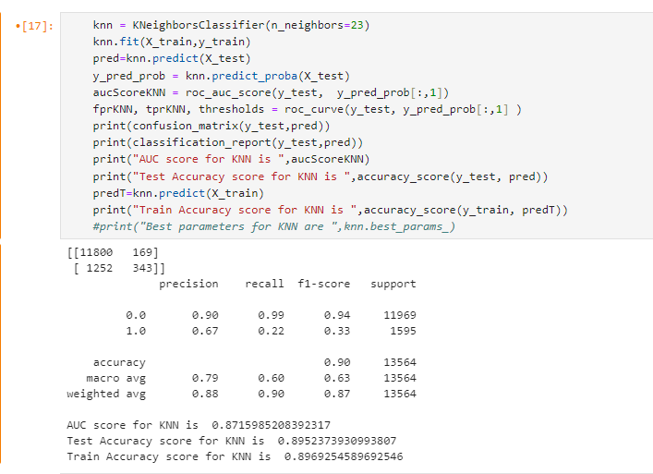
Predictive Model Building
K-Nearest Neighbour (KNN)

Slide 17
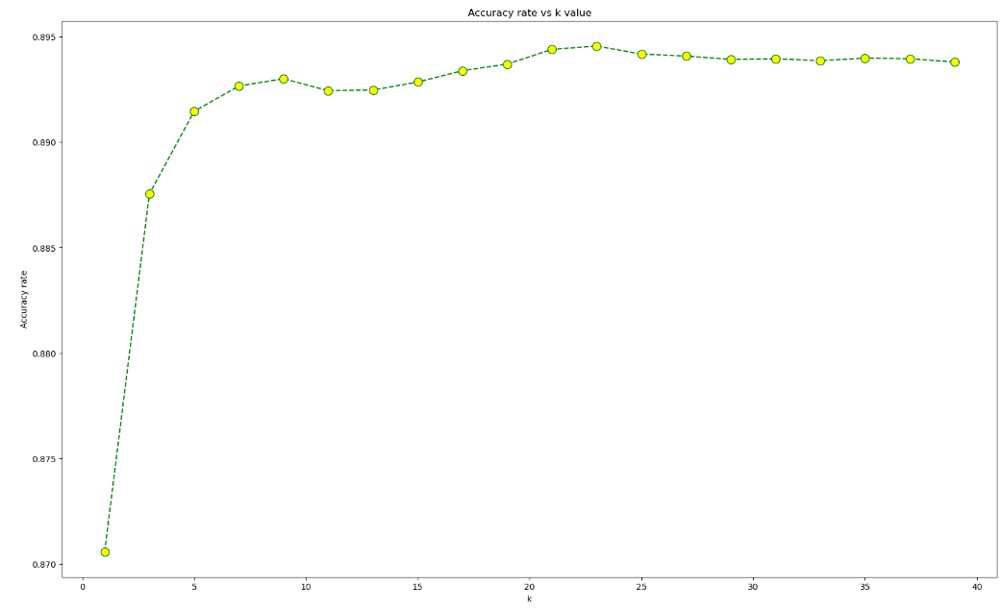
Analysing the K value with the accuracy rate

Slide 18
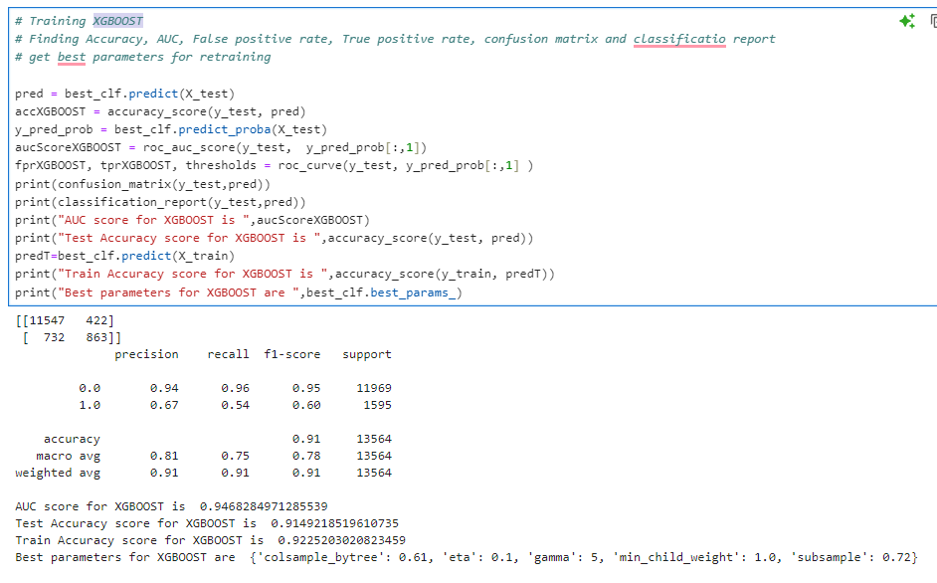
XGBOOST

Slide 19
Comparison of Results
SNO | ALGORITHM | Accuracy | AUC
1 | KNN | 0.89523 | 0.871
2 | XGBOOST | 0.914 | 0.946

Slide 20
Model Improvement Strategies
To boost your model's performance, you can try several strategies:
Feature Engineering: Create new features from your existing data to gain more insights. For example, combining age and income into an "income-to-age ratio" might help understand customer behavior better. Use effective methods to handle categorical variables, like one-hot encoding or target encoding.
Algorithm Selection: Test different machine learning algorithms to find the best one for your data. If you're using a basic model like logistic regression, try more advanced ones like Random Forests, Gradient Boosting Machines, or Neural Networks.
Cross-Validation: Use cross-validation to ensure your model performs well across different data subsets, which helps in preventing overfitting and assessing how well it generalizes.
Feature Selection: Identify and keep the most important features using methods like Recursive Feature Elimination (RFE) or feature importance scores. This can simplify your model and improve its performance.
Data Preprocessing: Make sure your data is clean and well-prepared. Handle missing values, normalize or standardize features if necessary, and address any class imbalances in your dataset.

